Slide 1
Using GIS to Optimize Presidential Campaigns
Adi Srikanth
Spring 2017

Slide 2
Overview
Research Question: Using GIS, can one construct an “ideal” campaign route revolving around the idea of making campaign stops based on when the people in a state make their presidential vote decision?
Background
From months of August-November, presidential candidates make their strongest push in terms of making campaign stops/hosting campaign rallies
Purpose
Modern day campaigning → data driven
Campaign finance is becoming tighter, allocation must be smarter

Slide 3
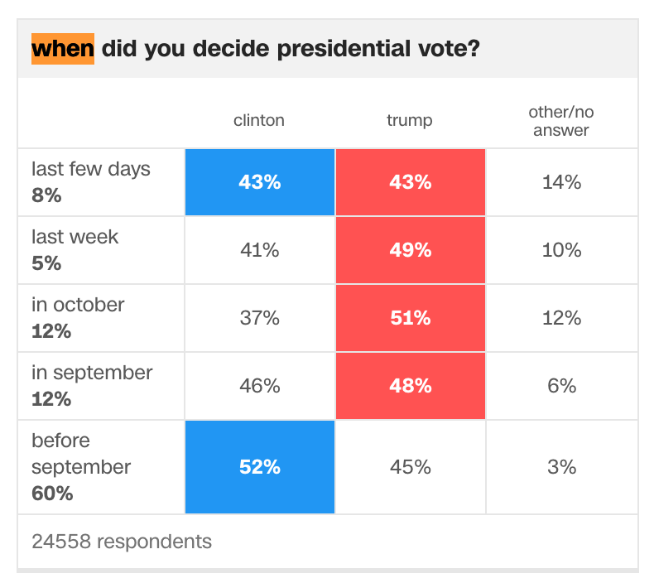
Methodology
Data Sources
2016 Presidential Election Exit Polls (CNN)
US States Polygon (GIS Tutorial)
US Cities with 2010 Population Data (ESRI)
Plan
Create map of US, categorize based on: votes, when state chooses who they vote for
Symbolize map to clarify/visualize data
Add cities that could be potential campaign stops, symbolize based on size
Based on potential stops and aforementioned data, draw route

Slide 4
Process
List of tools used:
Field Calculator
Calculate the number of votes up for grabs by combining the fields “Votes” and “Pct”
Buffer
Create a buffer around cities with populations 250,000 < x < 1,000,000
Dissolve
Dissolve states with insignificant number of votes, dissolve small cities that were nearby
Join
Join data from Excel spreadsheet to the imported data of US States
Identify
Create a hyperlink for states of intrigue
Editor (create features)
Create the actual route using line features

Slide 5
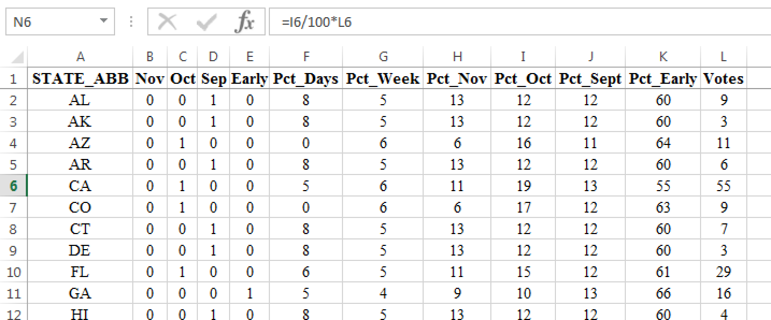
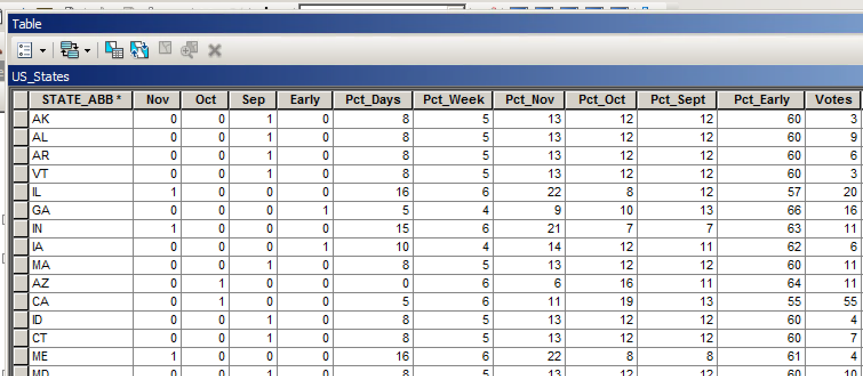
Join
Task: combine data from exit polls to geodata containing location, polygon information of US States
Join
Joined Excel Doc to US_States (from GIS tutorial)
Join on field State_ABBR and State_ABB

Slide 6
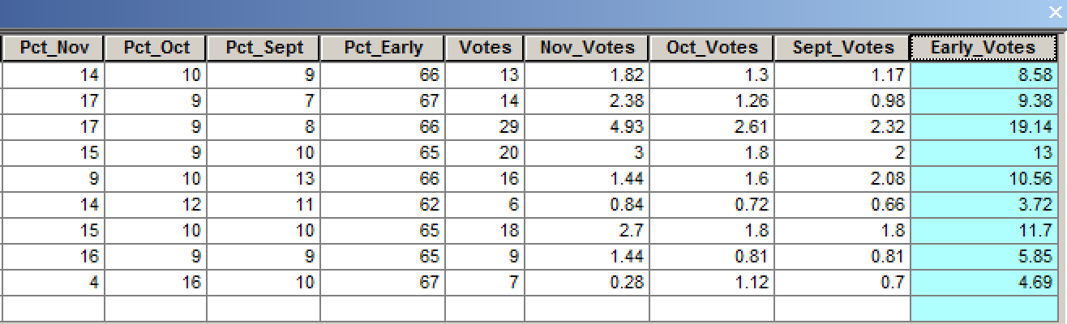
Field Calculator
Task: find the number of votes that are “up for grabs” at the point in time at which the campaign stop will be made
Early votes
Pct_Early / 100 * Votes

Slide 7
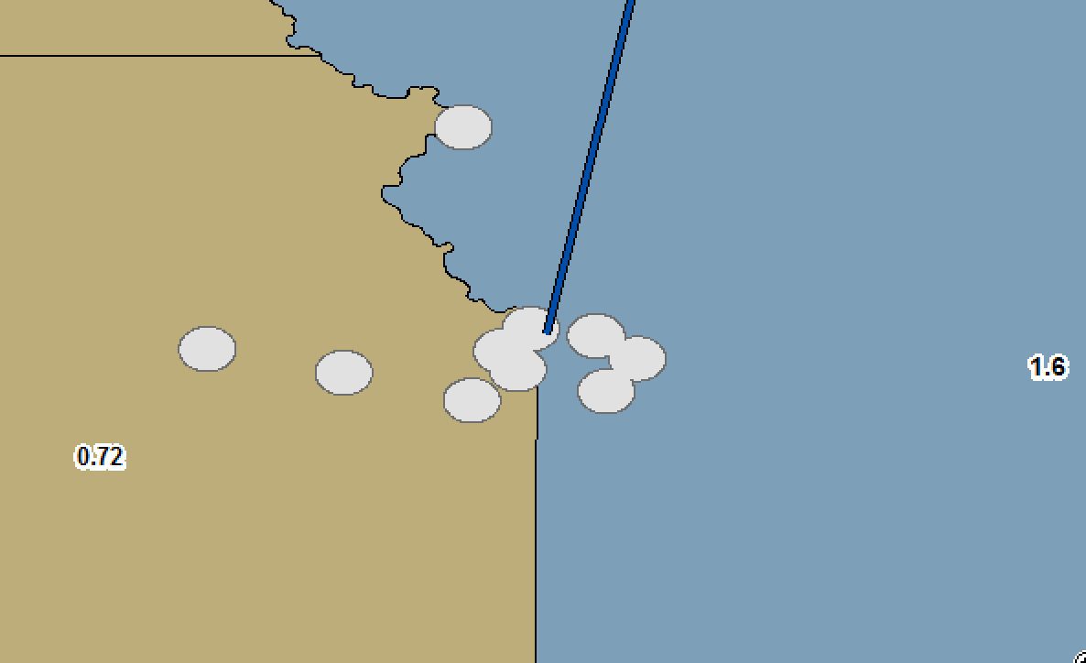
Buffer
Task: find out if there are small cities that are nearby, that could combine to make a reasonable campaign stop
Buffer
Made with a 15 mile radius around small cities (population 50,000 < x < 250,000)
Buffer was made using condition Dissolve = ALL

Slide 8
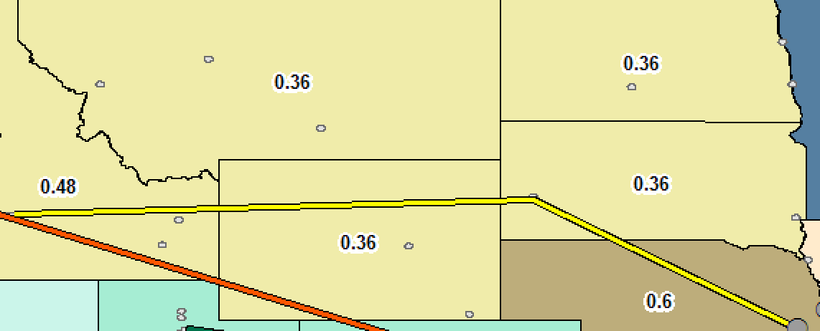
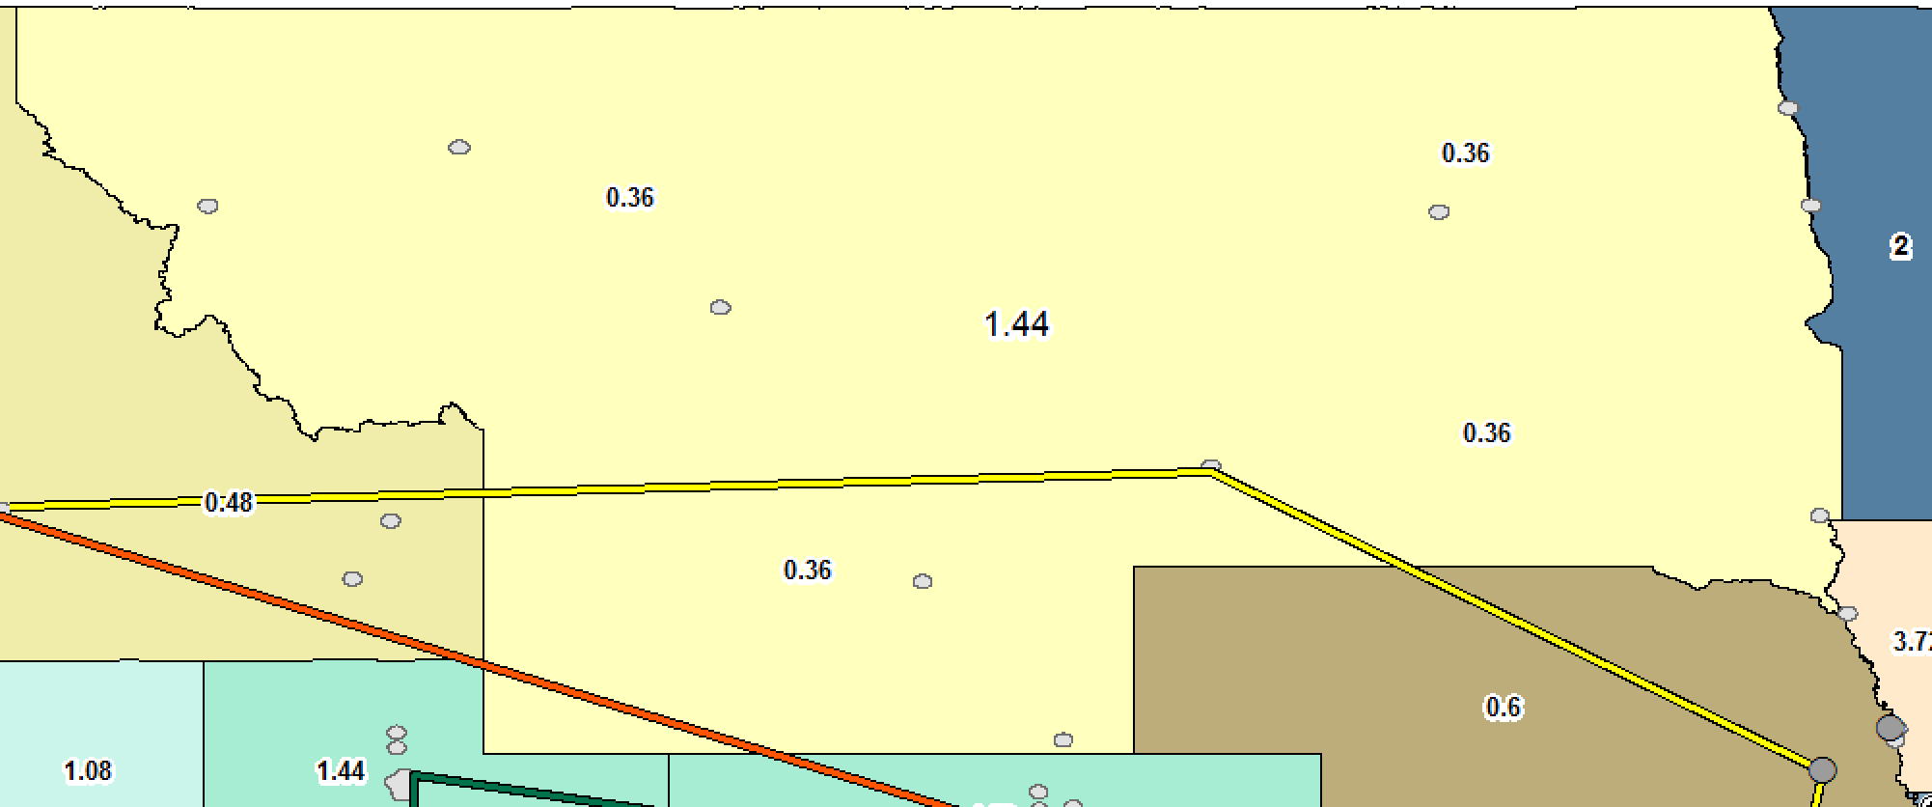
Dissolve
Task: consolidate states that have insignificant electoral votes that can be consolidated
Dissolve
Dissolve based on attribute Votes = 3
Combined 4 “irrelevant states” into 1 “relevant” region

Slide 9
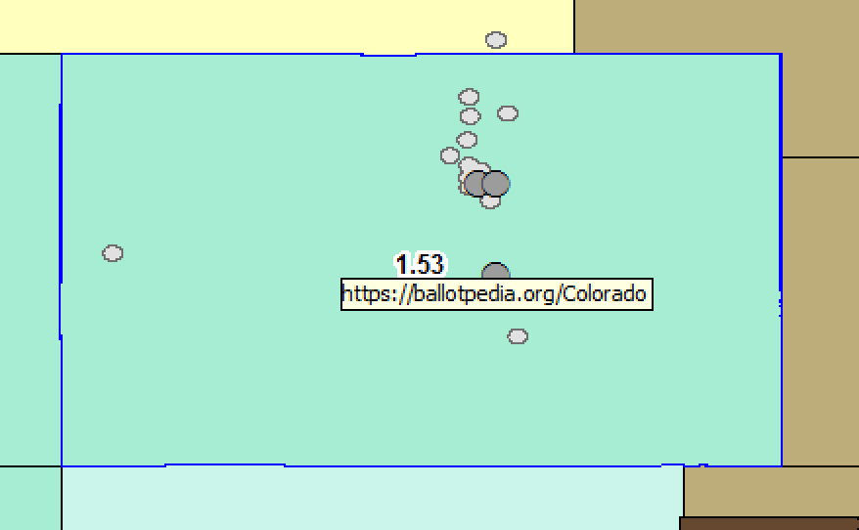
Identify
Task: keep the map up-to-date with relevant information
Identify
Use identify to identify “swing states” (per Politico)
Create a hyperlink with a link to ballotpedia for each swing state

Slide 10
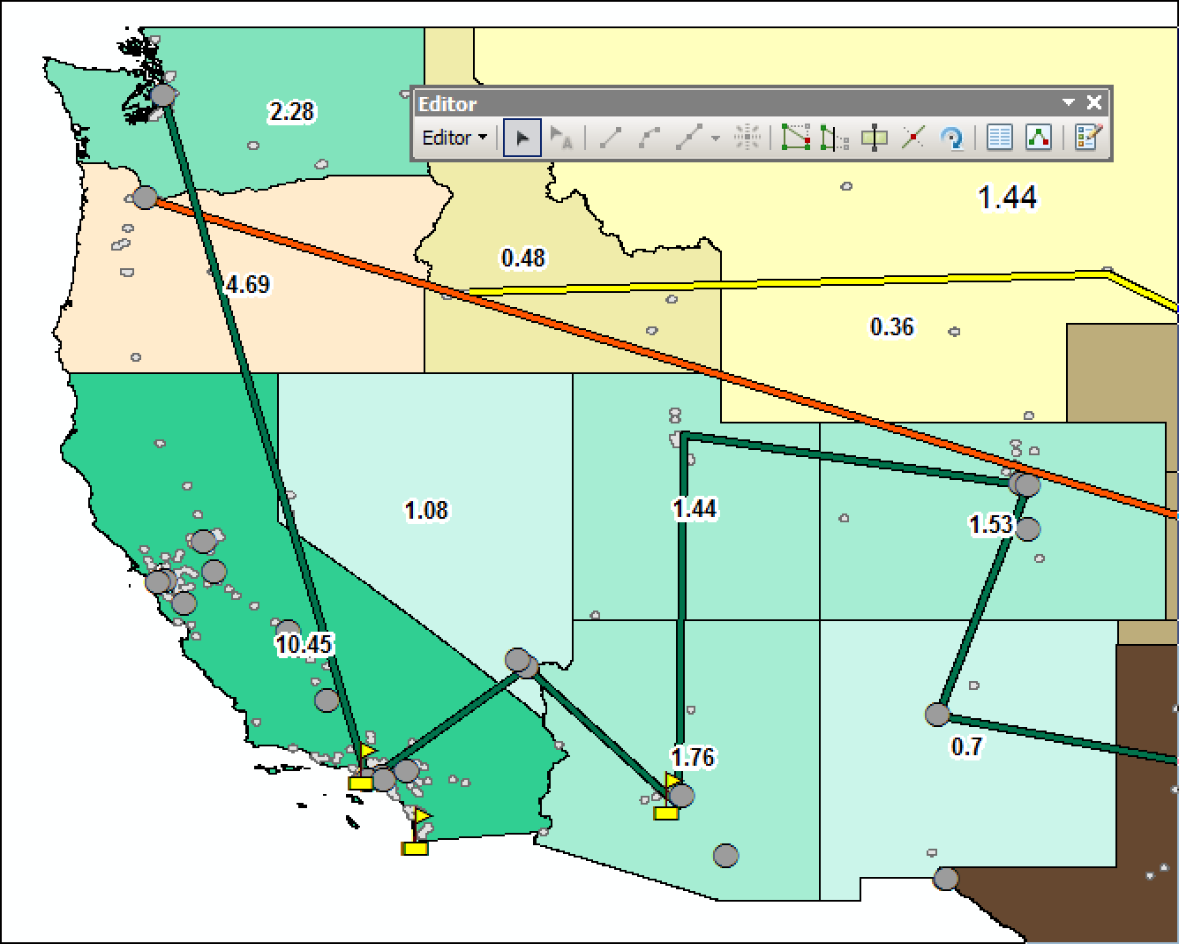
Editor
Task: create a visible campaign route for a candidate to follow during each time period
Editor
Used the editor toolbar to create line features and make them layers on the map

Slide 11
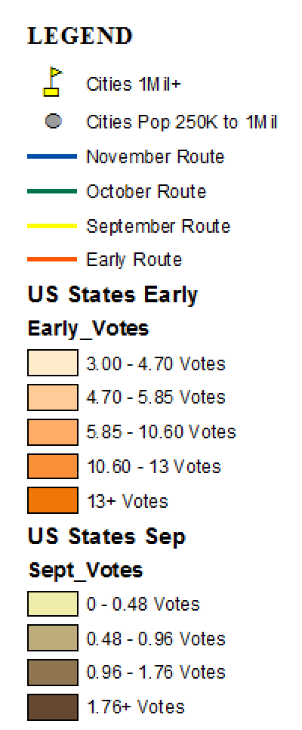
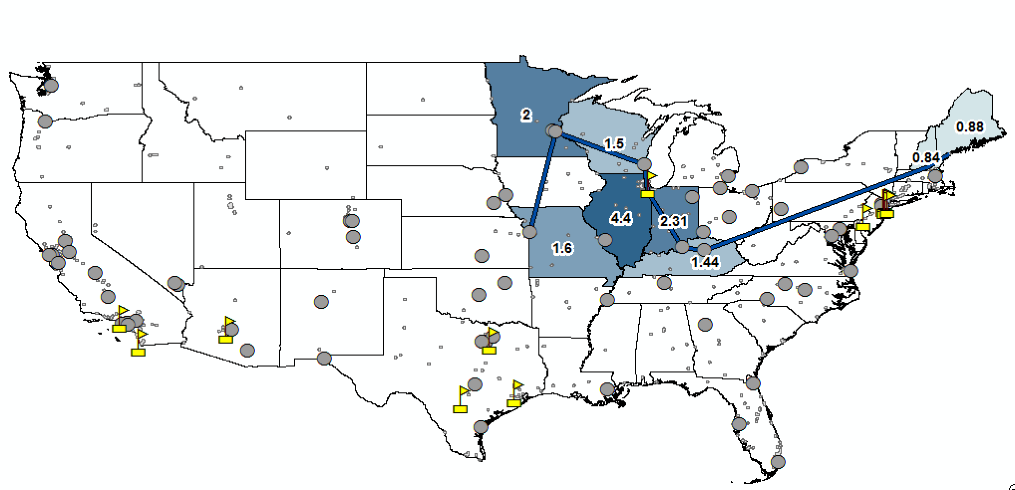
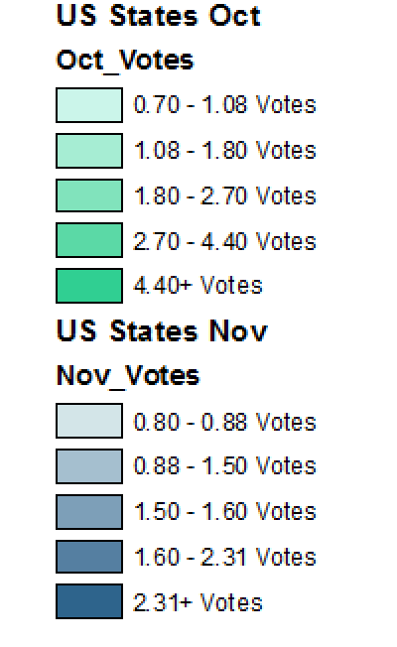
Results (scale omitted)

Slide 12
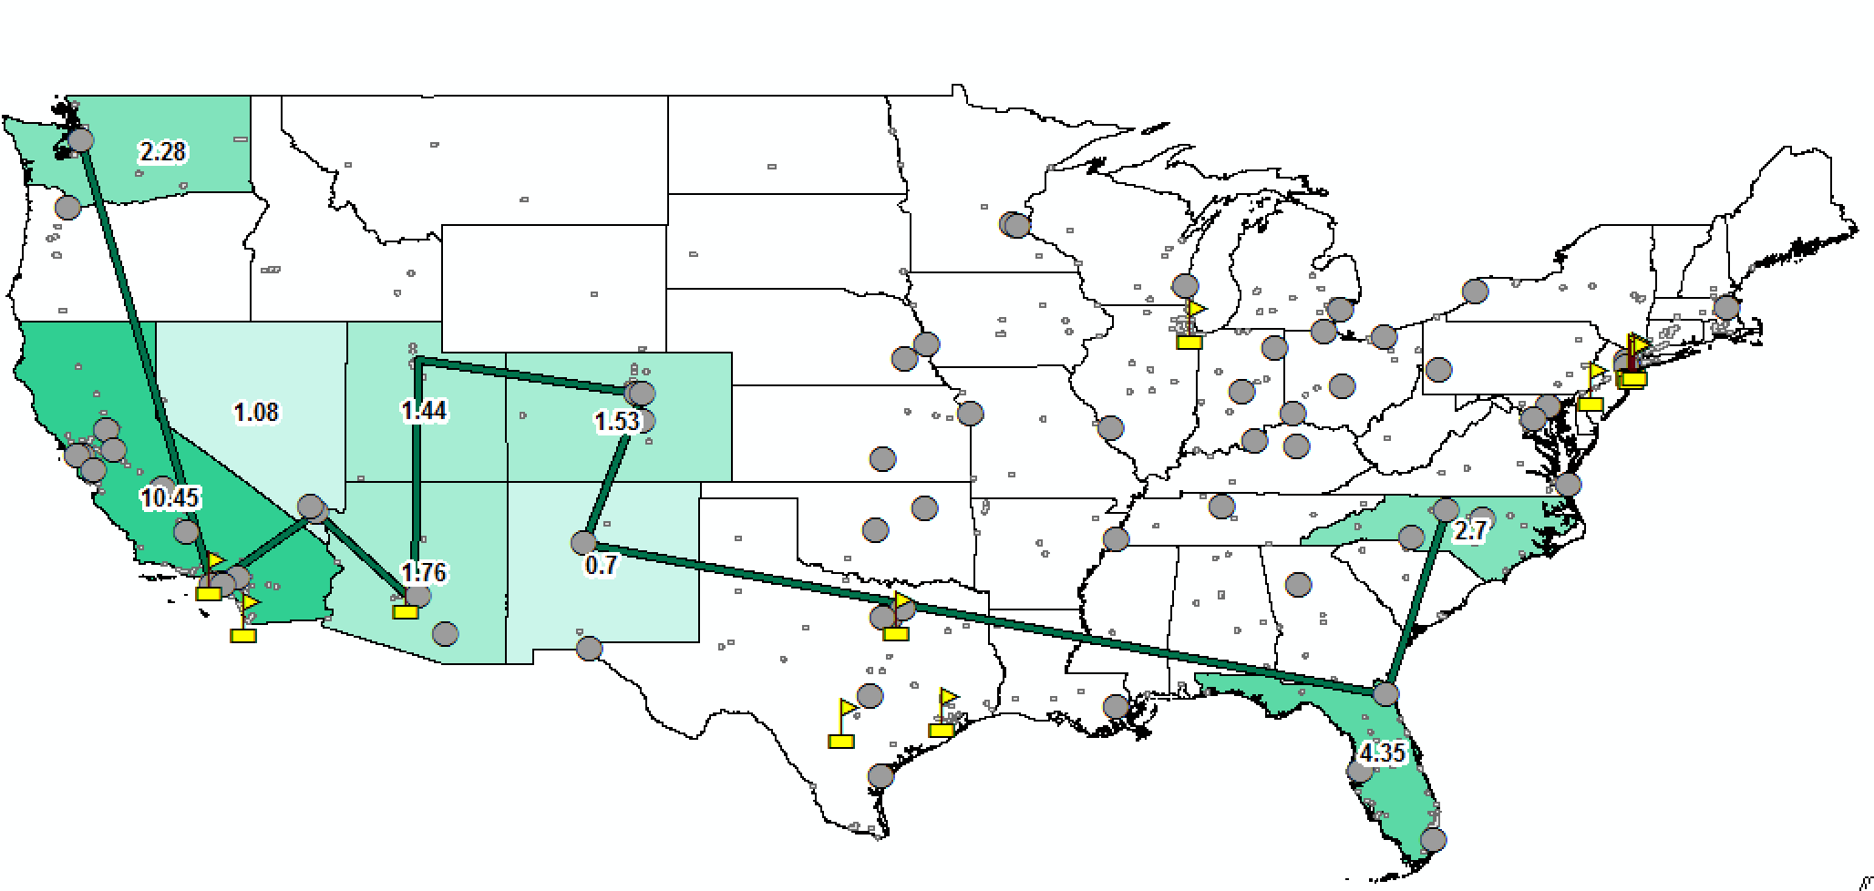
Results (scale omitted)

Slide 13
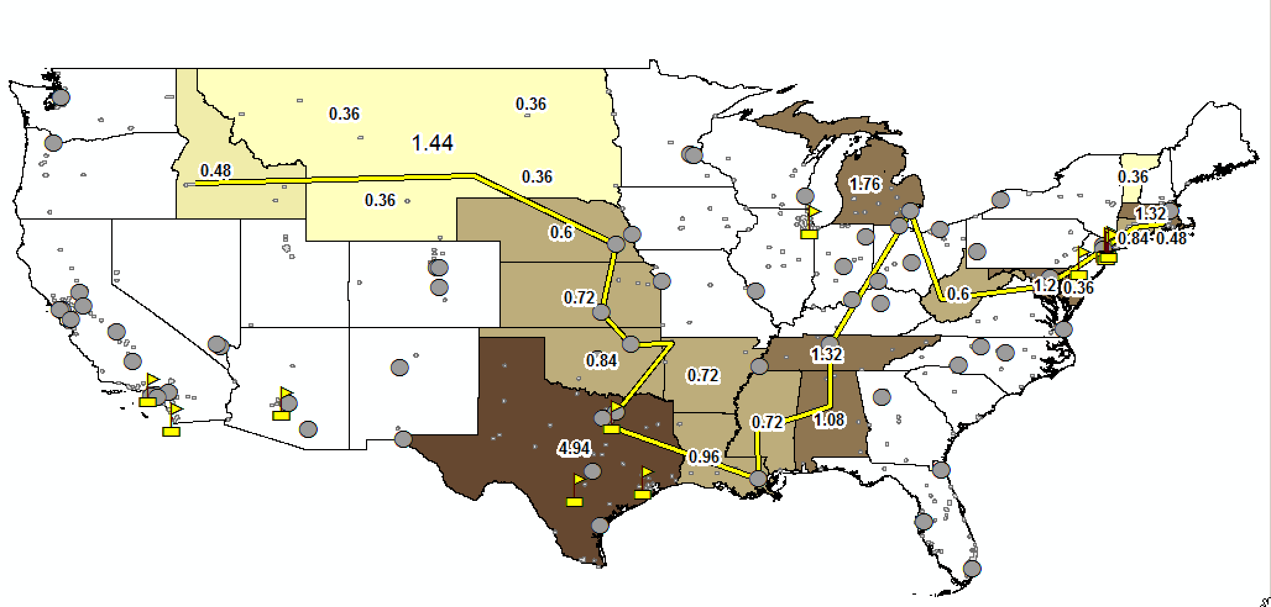
Results (scale omitted)

Slide 14
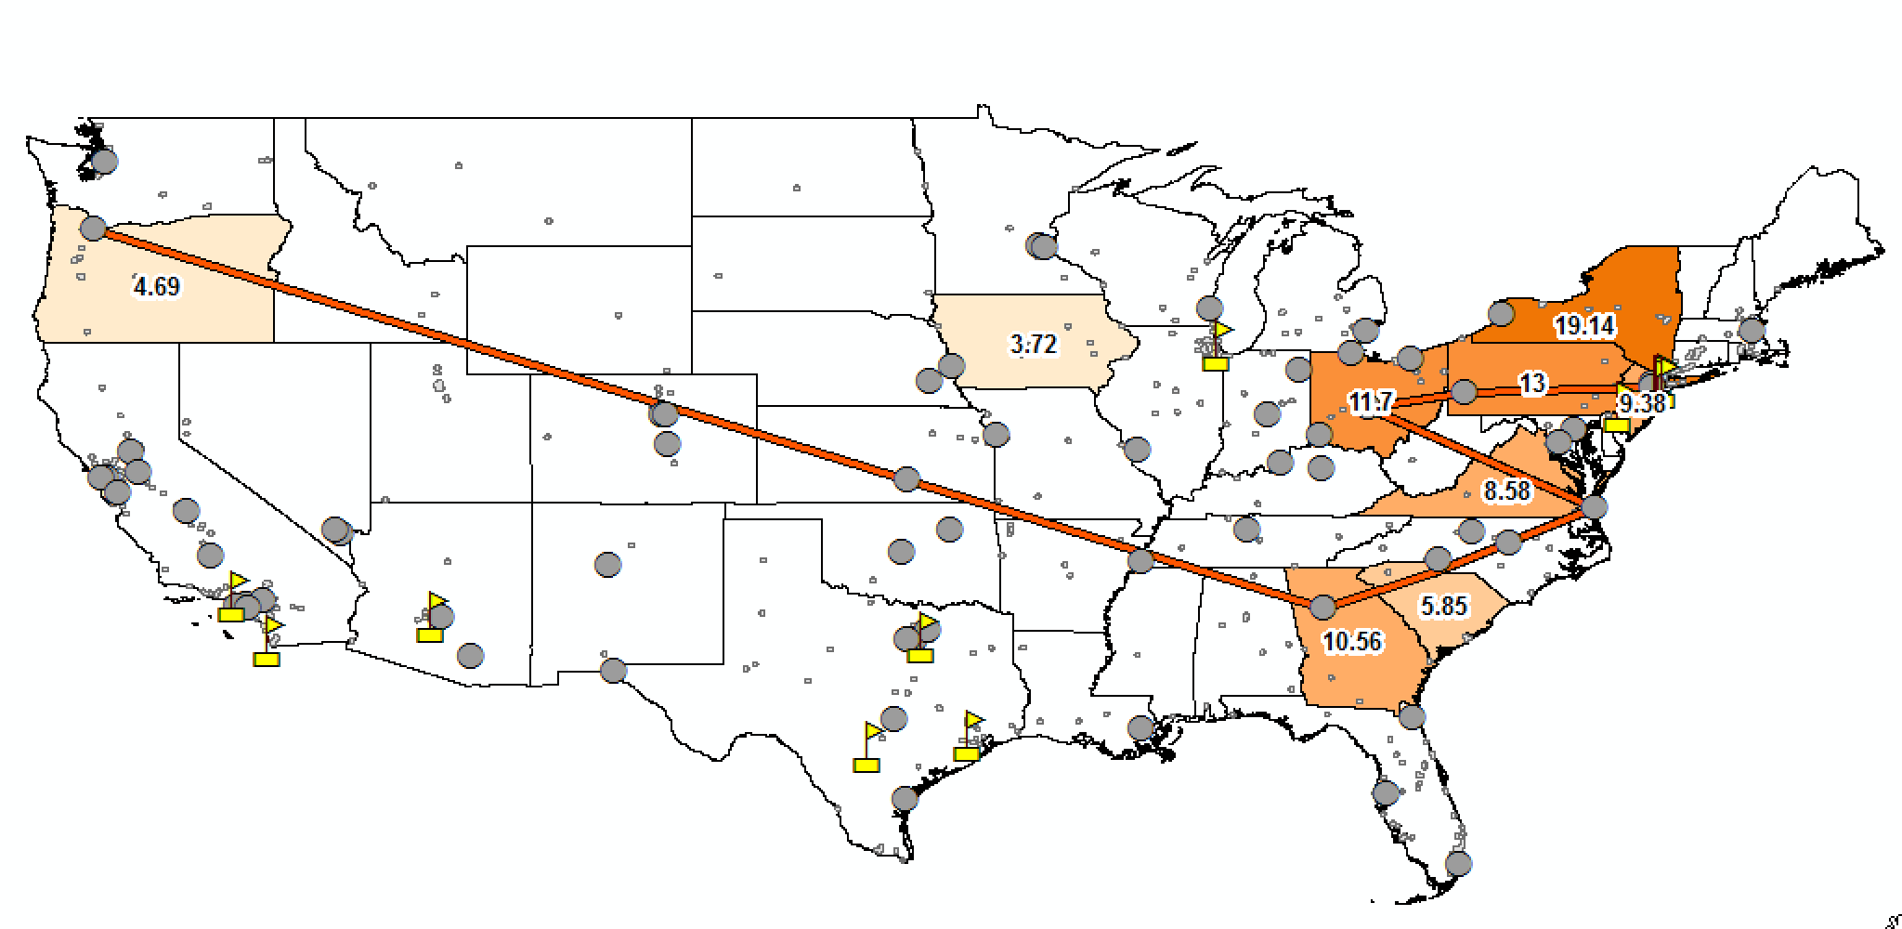
Results (scale omitted)

Slide 15
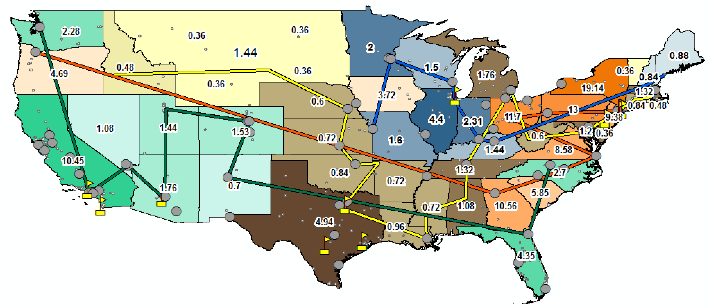
Results (scale omitted)

Slide 16
Takeaways
Geographic Clusters
West coast: October
East Coast: Pre-September
Central America: September
Upper-Midwest: November
Swing states are well-distributed
Each time period has at least one swing state
Not much happens in September
Least bang for your buck
Where to be, and when
Follow the geographic clusters!

Slide 17
Applications
Marketing/Advertising
When/where to run television advertisements based on consumption data
Presidential Campaign Route Model
Definitely will have to be tweaked, but idea can be developed
Resource allocation
Finite resources, when/where to spend them?
Grassroots organizations: when to begin work
”Floating” Headquarters
Move location of campaign HQ month to month

Slide 18
Limitations
Data
Could be more specific (e.g. when in September do they choose?)
Sample size around 1,500 responses per state
Electoral data is extremely volatile
Route drawing
Program to optimize routes in GIS was not free → routes were “eyeballed”
Omitted factors/considerations
“Red” states and ”Blue” states are often skipped for various reasons
Campaign stops are not always necessary
External political factors can impact the effectiveness of a campaign stop

Slide 19
Summary + Next Steps
Given the geographic clusters of states (based on when they decide to vote), there seems to be a general direction for the “ideal” campaign route
Main finding: it is attainable, shown by the routes, to hit almost every state at the “ideal” time
Next steps
Refine data
Use more accurate route drawing
Adjust for political factors

